Slide 1
Introduction to Text Mining
Max and Julie from AU Library, Det Kgl. Bibliotek

Slide 2
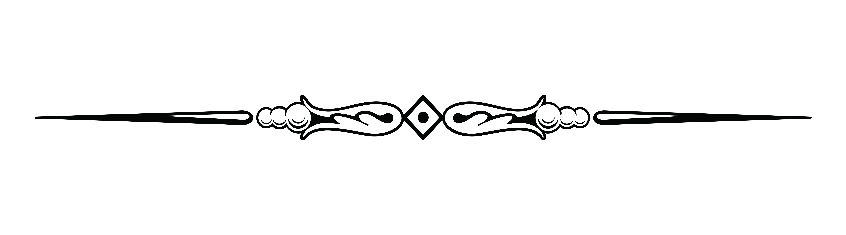
Motivation
to show that with a relatively small but fearless effort, you can get started with Text Mining
to give you some methods and tools

Slide 3
Introduction til
RStudio Cloud
R
The Rmd format
The tidytext principle
A small textual dataset
wordclouds
Term Frequency – Inversed Document Frequency (tf-idf)

Slide 4
Data corpus
Newspapers from St. Croix Avis from 1878
From the Royal Danish Library’s newspaper collection

Slide 5
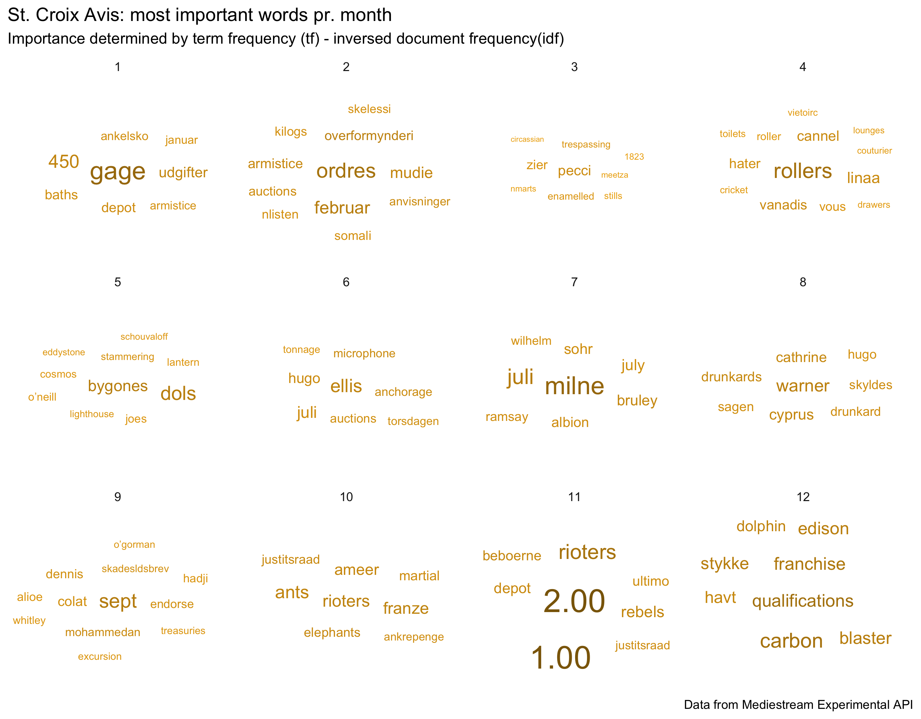
Todays goal

Slide 6
What we wont be talking about
(
)
How to find domain specific data
Data collection (can be the most time consuming part of a ”real” project)
Advanced analyses such as sentiment, named entity recognition (NER) and machine learning
versionering like git and other IT support tools
datatypes
programmering

Slide 7
The plan
Log in to Rstudio Cloud
Read in data to Rstudio Cloud
I will be walking through the code and you will repeat on your end
Online challenge: the analysis consists of several steps:
I will be demonstrating a step
You will repeat in your RStudio Cloud
We will move on when everybody has repeated the step
We will be getting errors and learning from them.
Conclusion

Slide 8
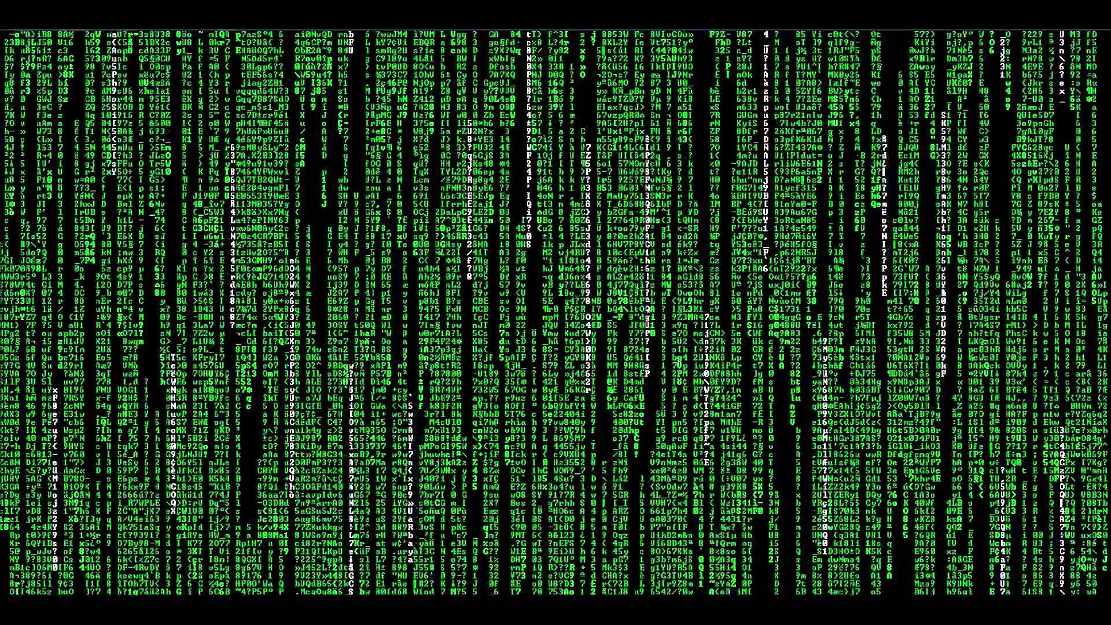
$ Live-kode

Slide 9
Good links
Text Mining with R https://www.tidytextmining.com
R for Data Science http://r4ds.had.co.nz
Data Visualization in R https://socviz.co
R Graph Gallery https://www.r-graph-gallery.com/
R Cheat Sheets https://rstudio.com/resources/cheatsheets/

Slide 10
Keep in touch!
Max maop@kb.dk

